Slide 1




INTRO TO CAD AND PCBS
By Sudhensh Reddy

Slide 2



CAD
Computer-aided design (CAD) is a way to digitally create 2D drawings and 3D models of real-world products before they are manufactured.

Slide 3


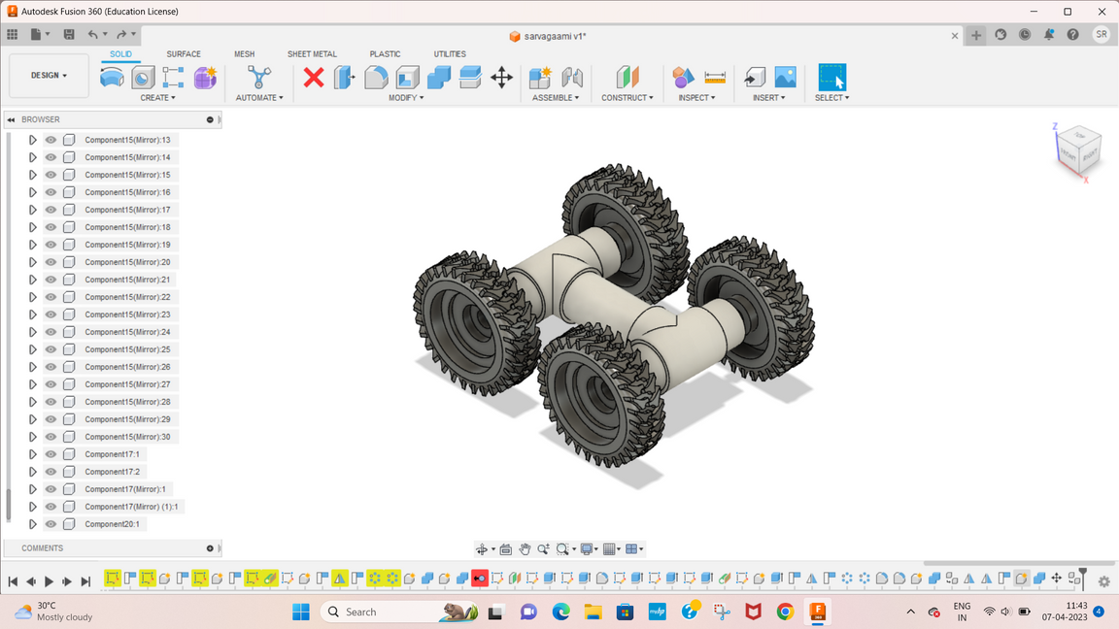
Uses
Increased Productivity
Information sharing
Reduced errors
Simulations
Animations
Aid in explanations
etc.

Slide 4

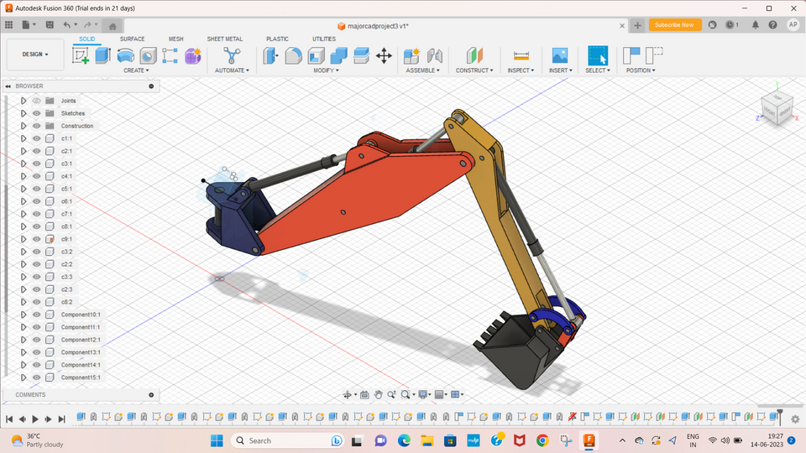
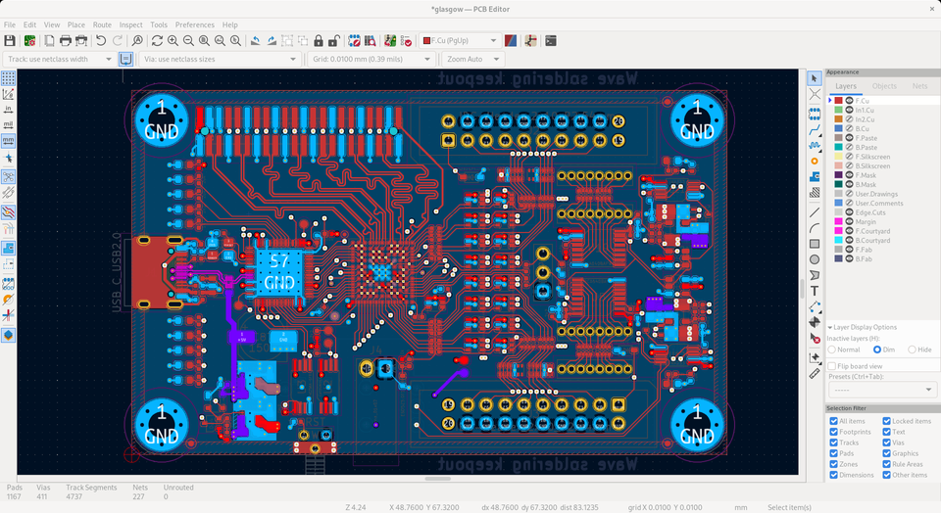
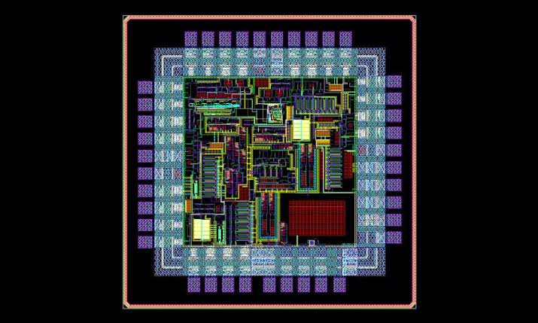

TYPES
Mechanics
PCBs
ICs(VLSI)

Slide 5

MECHANICS
DEF
SOFTWARES
Mechanical CAD (MCAD), also referred to as mechanical design automation (MDA), software enables mechanical engineers to create product designs with accurate and detailed technical drawings (2D or 3D models), and specifications for engineering and manufacturing.
Fusion 360
Solid works
AutoCAD
FreeCAD
TinkerCAD

Slide 6
PCB'S
DEF
SOFTWARES
Printed Circuit Board CAD design focuses on the layout of virtual components and their connections on the PCB. This subset relies on a specific type of Computer-Aided Manufacturing performed by CAM Engineers who are typically employed by PCB fabrication shops.
KiCAD
Eagle
Altair
Altium

Slide 7
IC'S
DEF
SOFTWARES
Siemens
Cadence
Synopsys
Xilinx Vivado
Integrated circuit design, or IC design, is a part of a larger body of knowledge known as electronics engineering.

Slide 8
FR4
Polyimide
SC
OC
Power loss
Complexity
PCB
A printed circuit board (PCB) is the board base for physically supporting and wiring the surface-mounted and socketed components in most electronics.

Slide 9

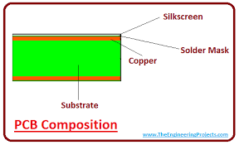
COMPOSITION

Slide 10
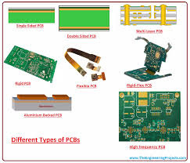

TYPES
Single sided
Double sided
Multilayered
Rigid
Flexible
Rigidflex
High frequency

Slide 11
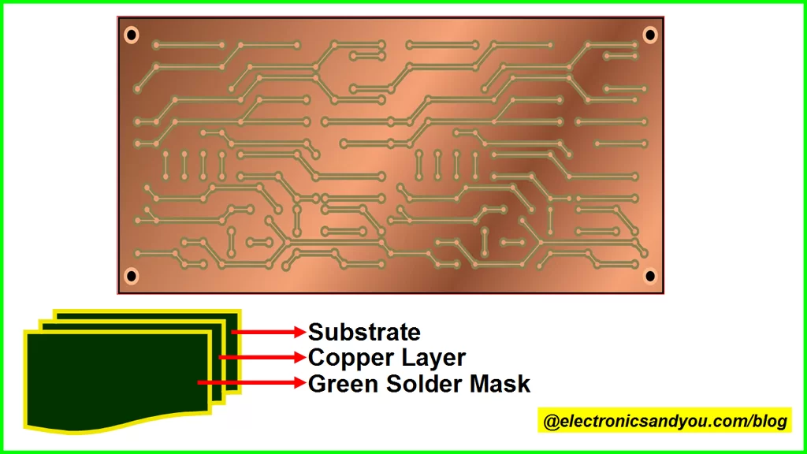
SINGLE SIDED

Slide 12
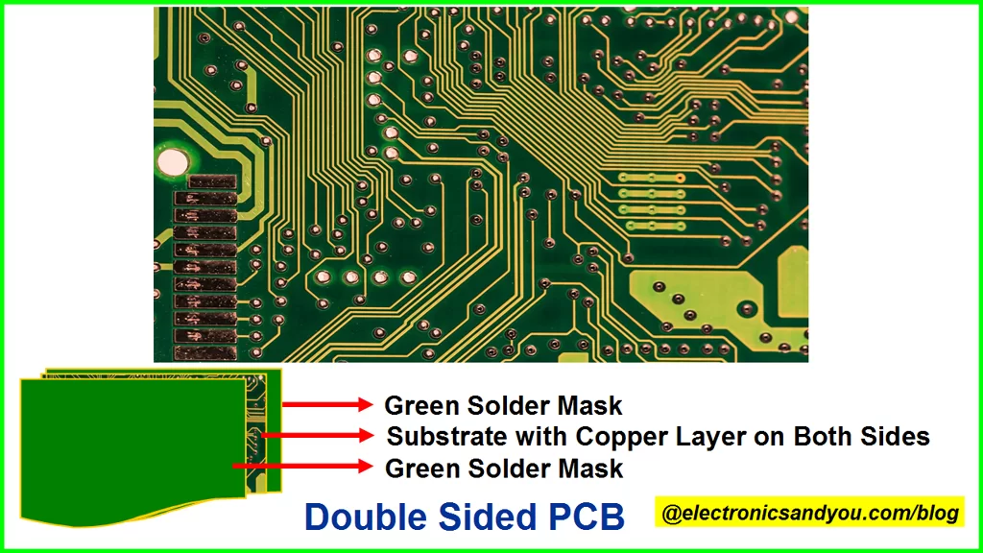
DOUBLE SIDED

Slide 13
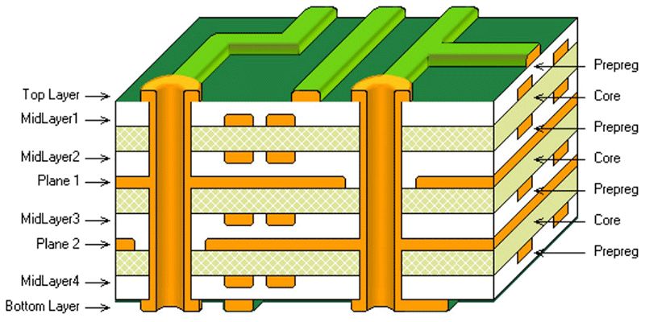
MULTILAYERED

Slide 14
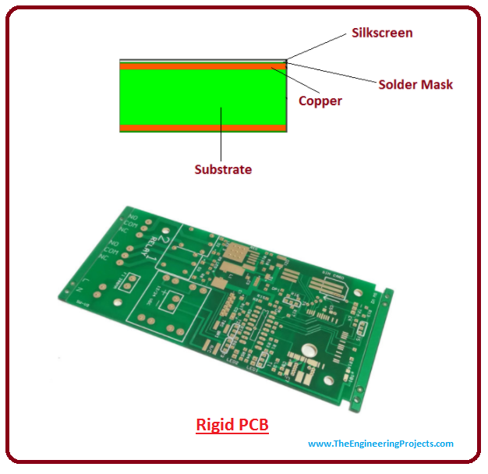
RIGID

Slide 15
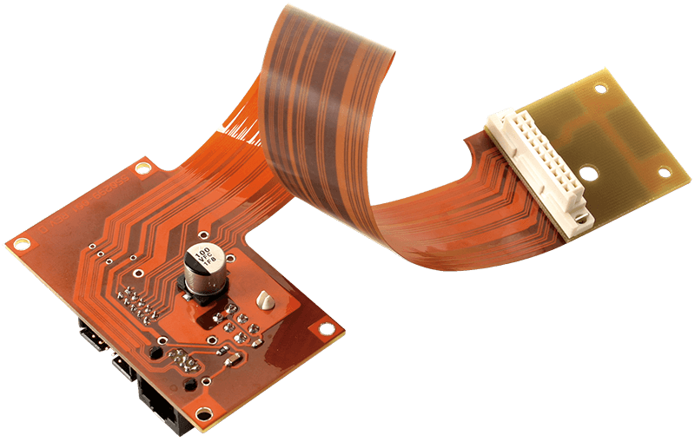
FLEXIBLE

Slide 16
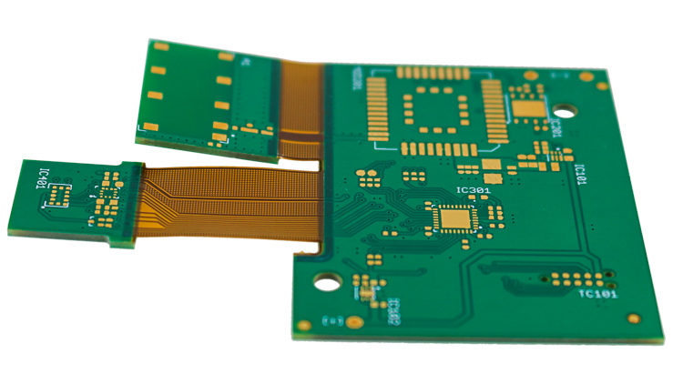
RIGID-FLEX

Slide 17
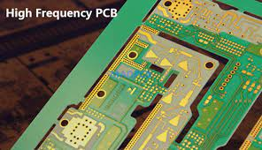
HIGH FREQ.

Slide 18
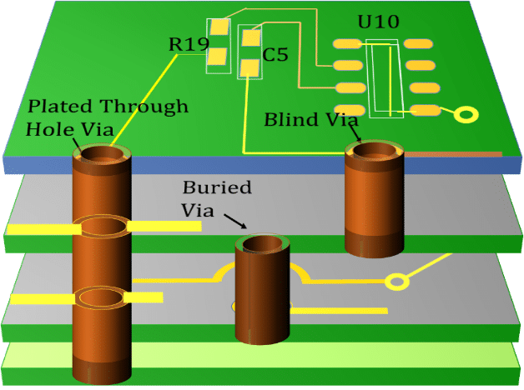
VIA'S

Slide 19
FILE FORMATS
Gerber files
IPC files
Drill files
BOM files
Fab drawings

